Slide 1
Event Source Actor
Subscriber – Publisher in Actor Oriented System
Piotr Kruczkowski CLA
Software Solutions Developer

Slide 2
Agenda
Introduction
Reusability
Zero coupling messaging
Event Source Actor
Use cases
Tutorial
Creating Event Source with Events
Creating Implementations for Events and using Event Source
Integration
Details
Q&A

Slide 3
Introduction
Many actor systems need to break the tree hierarchy for communication
This can introduce difficult and strange practices, connections
Needs to be tracked and debugged
Should be standardized
Should be extensible and decoupled
Event based approach is proven to work

Slide 4
Reusablity
Limited with coupling
Only loading what is needed
Reusable system needs to have all interfaces defined and understood
Interactions between modules should be limited to usage of interfaces
Calling methods
Messages
Inheritance and override
Plugins

Slide 5
Zero coupling messaging
The message defines the functionality
Messaging actor B from actor A loads actor B as actor A dependency
This causes tight coupling
To solve it you need an interface that will be loaded instead of actor B
You then implement concrete methods using the interface
Requirement for real in AOD
Prevents dependency linking
Provides a clean interface
Removes coupling

Slide 6


The Problem Is…
Reusable Actor
Caller
Message Direction
Caller
Message
Notes:
The core of the problem is that both the caller and its nested actor get linked to something that is specific to the caller – the message class.
What can we do about this?

Slide 7
Dependency Inversion
We need to reverse this dependency
Reusable Actor Library
Caller Actor Library
Reusable Actor
Caller
Message
Notes:
The answer lies in a concept called dependency inversion.
Our nested actor depends on something contained in the caller’s library – namely, the message that Nested wants to send to Caller.
We need to flip this dependency.

Slide 8
Dependency Inversion
Dependency inverted!
Nested Actor Library
Caller Actor Library
Nested Actor
Caller
Abstract Message
Message
Caller’s message inherits from abstract class
Notes:
Here is how to invert the dependency between two libraries.
Identify the class that drives the dependency relationship – in this case, it is the message class that Nested needs to send to Caller.
Create an abstract class with some or all of the methods that need to be called from the dependent library, and put this class in that library.
Make the concrete class – our message class – inherit from the new abstract class.
Your dependency is now inverted.

Slide 9
Zero Coupling
Nested Actor
Caller
Caller
Message Direction
Message
Notes:
Let’s apply this technique to our caller’s message. We’ll call the result “Zero Coupling”.
Recall that a message class consists of two parts – a Send method, which packages up some data and sends it to the recipient, and a Do method, which invokes some method of the recipient. Both are part of the same class, and so have access to the same data.

Slide 10
Zero Coupling
Nested Actor
Caller
Message Direction
Message
Notes:
The Do.vi of our message must depend on Caller, because it invokes a method of Caller. It needs to stay in Caller’s library.
Nested doesn’t care at all about Do.vi, but it must be able to package its data into the message and send it to Caller. The Send VI needs to reside in Nested’s library.

Slide 11
Dependency Inversion
Nested Actor Library
Caller Actor Library
Nested Actor
Caller
Virtual
Method
Has a virtual Do.vi
Has no Send VI
Notes:
Knowing this, we can define an abstract class for the Nested actor, and a concrete child implementation for the Caller actor.
Nested’s abstract message class defines the data that will be sent to Caller, and implements a Send VI. [Build] It does not implement an override of Do.vi, leaving that method virtual. This class is added to Nested’s library, and becomes part of its API.
Caller gets a concrete child implementation of Nested’s abstract message. [Build] This child class has no data of its own, and does not implement a Send VI. It does provide an override of Do.vi, which invokes a Caller method as normal.
This is Zero Coupling. Note that the term applies to how Nested couples to Caller – which is to say, not at all. Caller is still coupled to Nested, but that’s OK – Callers get to know everything about the APIs of their Nested actors.
Let’s see how this works in practice.

Slide 12
Zero coupling messaging
The message defines the functionality
Messaging actor B from actor A loads actor B as actor A dependency
This causes tight coupling
To solve it you need an interface that will be loaded instead of actor B
You then implement concrete methods using the interface
Requirement for real in AOD
Prevents dependency linking
Provides a clean interface
Removes coupling

Slide 13
Subscriber Publisher
Actors subscribe to receive data
Event Source Actor only works with subscribed Actors
Event Source Actor launched before Actors that Subscribe
Event driven behavior is the AOD guiding principle
Reacting gracefully to Actors being stopped - Unsubscribing
Sharing the address by Subscribing
Benefits of direct communication
Plays nice with zero coupling
Tree hierarchy is broken
Debugging techniques become more important i.e. DETT

Slide 14


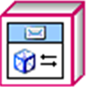
Subscriber - Publisher

Slide 15
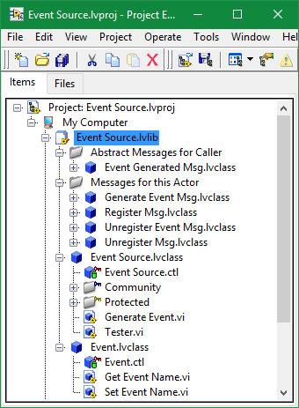
Event Source Actor
Subscriber – Publisher pattern
Actors register to receive event notifications
Actors unregister to stop receiveing the updates
Standardized mechanism available through inheritance
Any actor can become an Event Source Actor and gain all the abilities of Event Source
Event Source Actor generates events on his own schedule
All subscribed actors get notified to handle the event with their own implementations

Slide 16
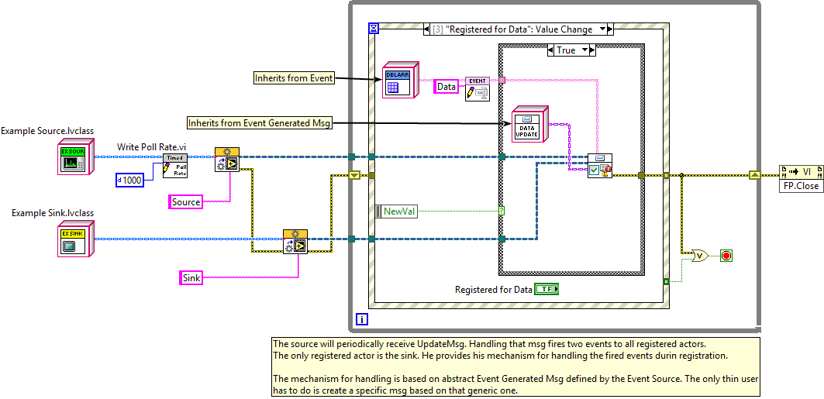
Custom Application - Send Register Message

Slide 17
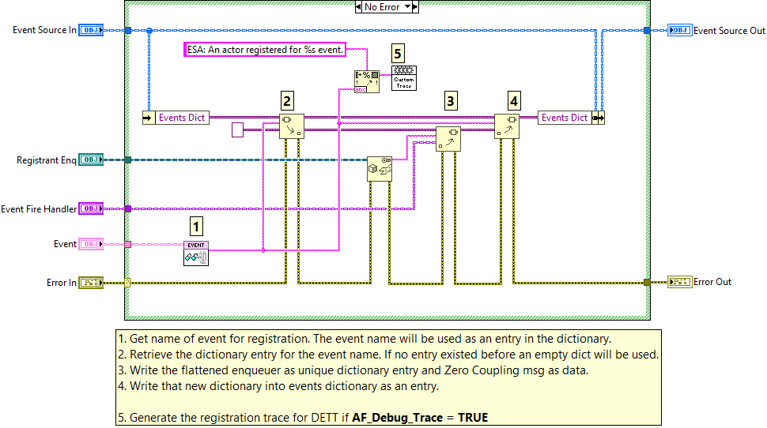
Clockwork - Register Method

Slide 18
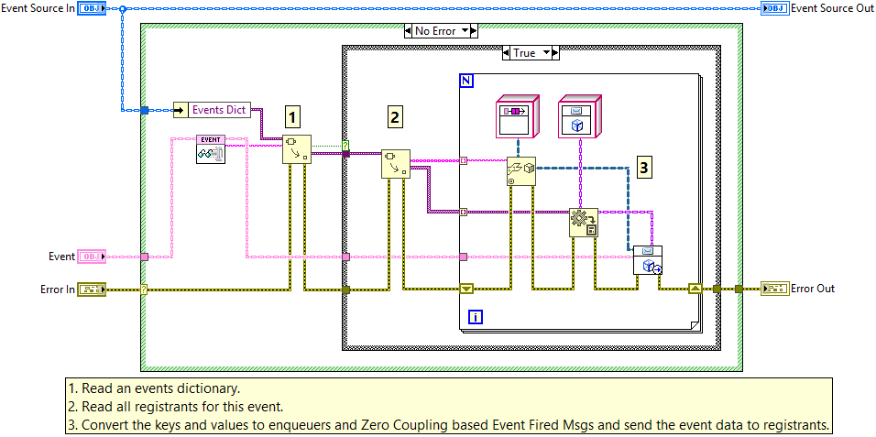
Clockwork - Generate Event

Slide 19
Event.lvclass
Defines the format of data of the event
Base class has only a name
Subscriptions are based on the name of the event
Usually just a getter and setter are needed in children
Q: Why not directly use ZC messages? Why add another layer of events?
A: Because the publishing mechanism needs to have an ability to pass messages to all registrants based on event name, therefore the data type has to be unified and one interface needs to be used.
Q: How are events different from messages?
A: Messages include sending and doing functionality besides defining the data type. Events only define the data type. Sending is done by event actor, and doing is done by registered actor. The abstract message is the Event Generated.lvclass

Slide 20
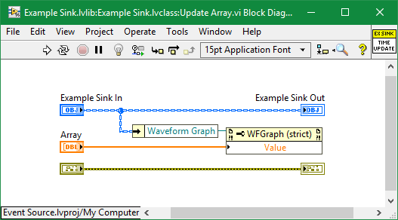
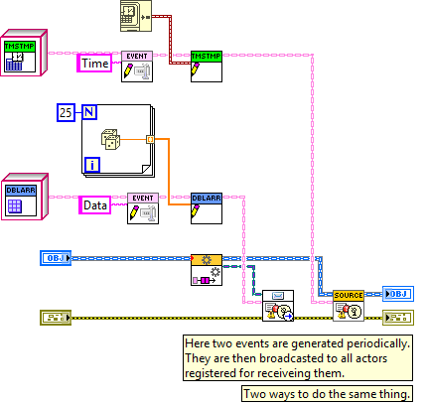
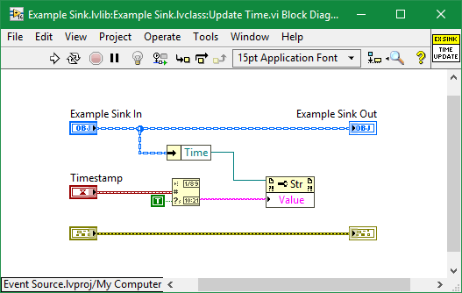
Custom Application – Generating and Handling Events

Slide 21
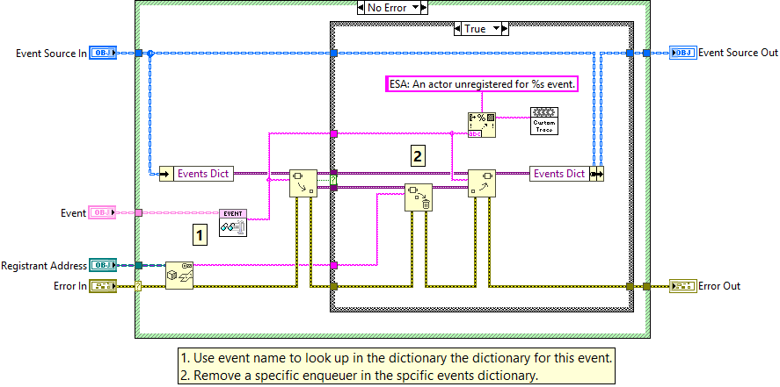
Clockwork - Unregister Method

Slide 22
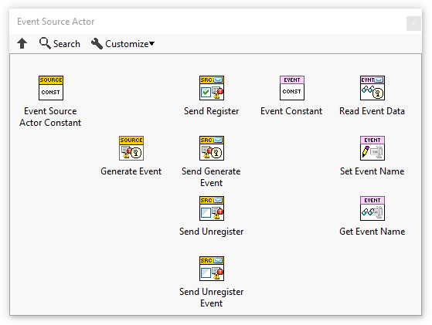
Event Source Actor Package
VIPM package
Includes the example shown
Includes the palette to simplify working with ESA
Available @ni.com

Slide 23
Integrated Solution

Slide 24
Use cases
Measurement complete events in DAQ tasks
Data ready event
User clicked event in UI tasks
Button clicked event
Long task completed in Processing tasks
Processed data event
Any actor oriented communication outside the tree comms hierarchy

Slide 25
Creating Event Source with Events
Create or select the class to become Event Source
Add ESA to data of your class or make the class inherit from Event Source Actor
Create the event classes that your Event Source will generate
Event classes define the event type and its data
Create a constructor/destructor or getter/setter for the data in your events
Make them inherit from Event.lvclass
Add calls to Generate Event Or Send Generate Event Msg method inside the functions of Event Source, whenever an event is to be generated
Write the data using a setter into your generated event object, if you want registrants to receive it
If an event is generated in a helper loop, send yourself (or your composed ESA) the Generate Event Msg instead (so that the event is generated from inside the Actor Core, and the registrants can be notified)
Any actor that registers to this event will be notified whenever its generated

Slide 26
Creating Event Source with Events

Slide 27
Creating Implementations for Events and using Event Source
Create messages from abstract message based on handler methods
Select the Event Generated Msg as the abstract message you want to inherit from
Use Read Event Data method and provide a translation of the data in the Do.vi, from the event to the input of the called method
If the event has a destructor returning data or getter method, you can use it here

Slide 28
Creating Implementations for Events and using Event Source

Slide 29
Integration
Instantiate and run both event source and event registrant actors
Register for events from registrant actor
Generate events in the source
See that your registrant handles events correctly
Unregister when finished or when stopping

Slide 30
Integration

Slide 31
Details
Event Source Actor uses dictionaries to keep track of registrants
Class names are used as the keys in the dictionary

